Slide 1

Find What Feels Good:
Predicting YouTube Views for Yoga Channels
Exploring Linear Regression Limits
Elena Dubova

Slide 2


What’s special about Yoga Channels?
multiple views per person
emotional involvement
Notes:
Backstory:
What’s special about Yoga Channels?
multiple views per person
leading role of instructor charisma that is hard to derive from statistics
I have a favorite yoga channel, and my interaction with this channel differs fundamentally from other channels. The core difference is that I relay one and the same video many times.
I believe that success of yoga videos depends mostly on personality of instructor, but I was curious if one can collect statistics and predict number of views out of it.
Also, I wanted to study dependencies and infer important statistical features that drive channel views.
Why views?
For Yoga specifically views are indicator of quality in contrast with other scenarios:
News
Hate
Entertainment
Inferential, than prediction.
What ar the right predictors for yoga instructors, then prediction
As you watch only when you are actively involved – do the exercise!
Personal story, motivation: I replayed a video myself 3 douzen times as it is a kind of youga that feels good and is relatively short.
? Feature engeneeirng: views/length??? Dependent variable?
??? Definition of a view
My favorite yoga channel

Slide 3



Project Overview
transform features
predict # views per video
study predictive power of features
study influence of outliers
collect channel & videos statistics
Notes:
Definition of view!!
Scrape statistics about yoga channels and videos from YouTube
Using linear regression models predict number of views per video
Study predictive power of various features
Study influence of outliers on the quality of prediction

Slide 4
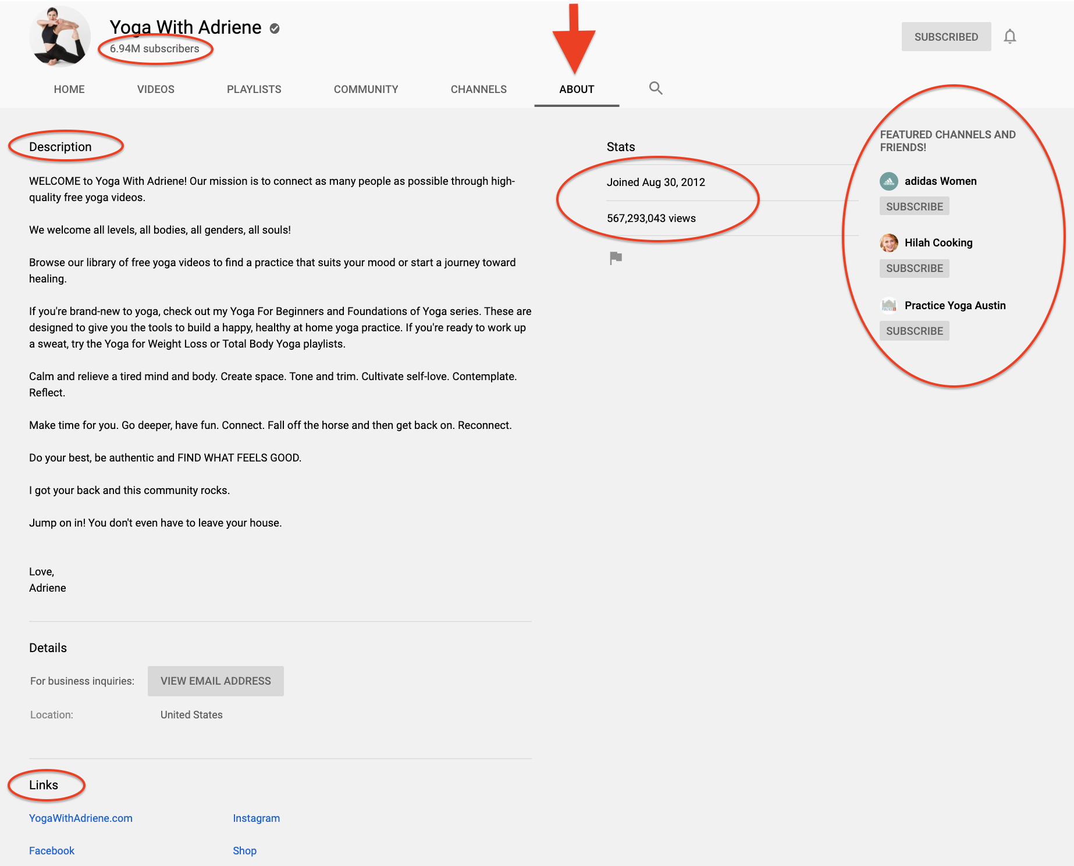
Scraping Channels
# subscribers
# total views
# featured channels
# marketing links
description
created date
Notes:
Scrape statistics about yoga channels and videos from YouTube
Using linear regression models predict number of views per video
Study predictive power of various features
Study influence of outliers on the quality of prediction

Slide 5
Scraping Videos
For up to 30 first videos:
# video duration
# video views
# video age
Notes:
Scrape statistics about yoga channels and videos from YouTube
Using linear regression models predict number of views per video
Study predictive power of various features
Study influence of outliers on the quality of prediction

Slide 6
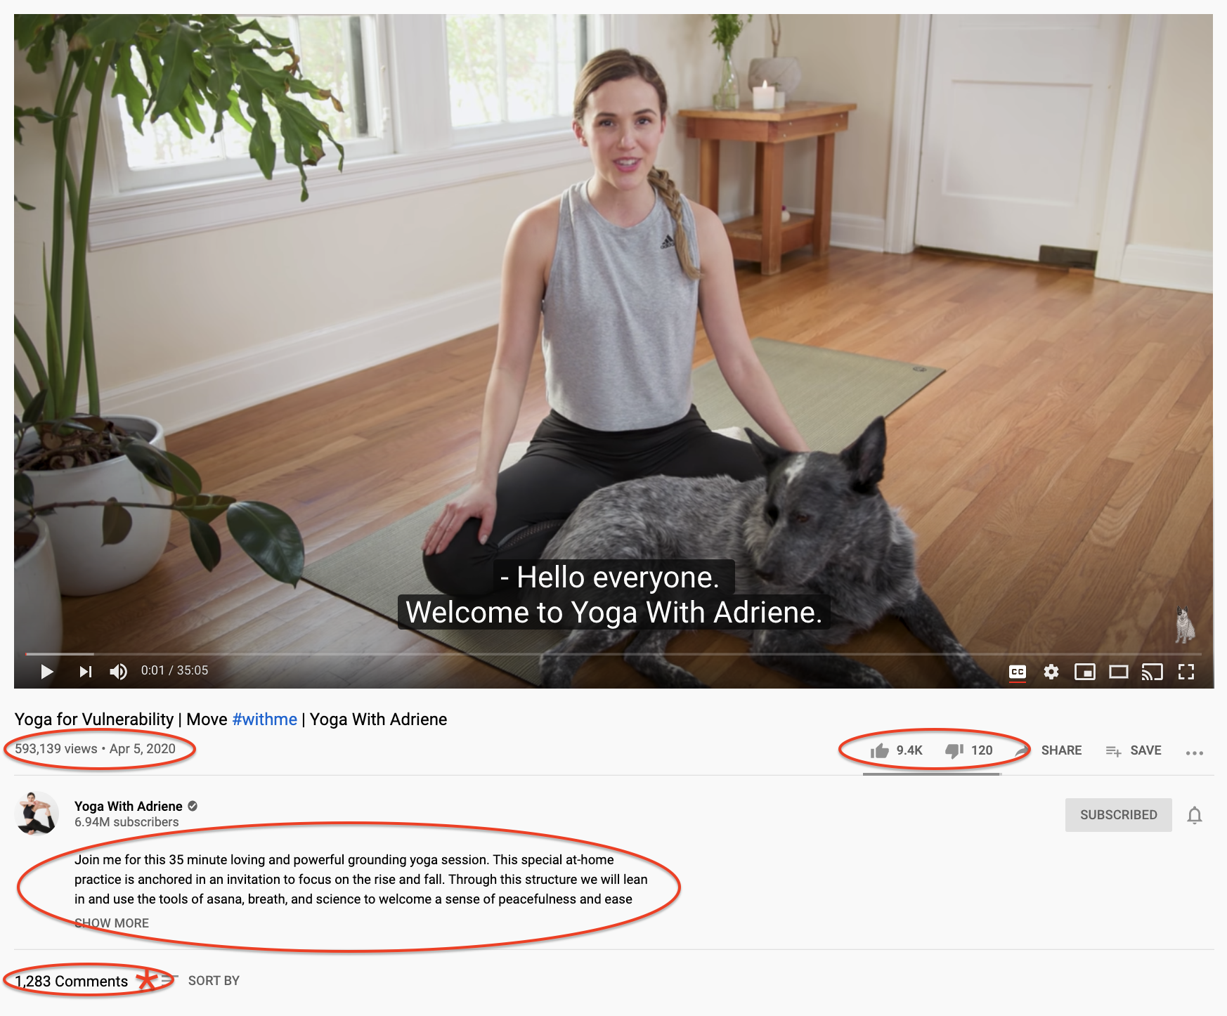
Scraping Videos
For up to 30 first videos:
# video views
# video age
# likes
# dislikes
description
delivery method
#comments (not quite)
Notes:
Scrape statistics about yoga channels and videos from YouTube
Using linear regression models predict number of views per video
Study predictive power of various features
Study influence of outliers on the quality of prediction

Slide 7

Dataset & Features
Feature engineering:
sentiment scores, text length
categorical, dates to numeric
channel-level aggregations
polynomials, interaction terms
8162 observations
25 variables

Slide 8
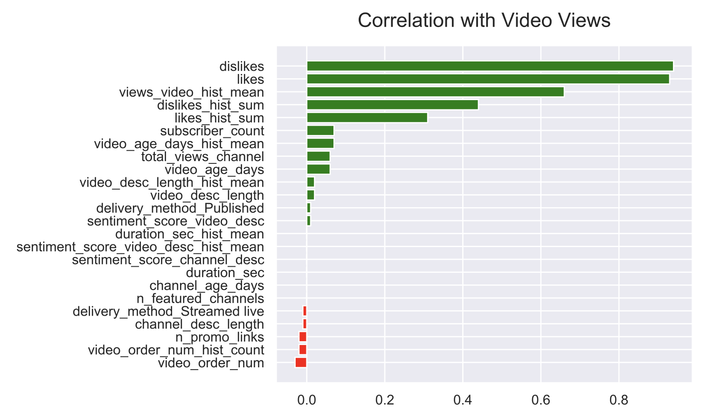
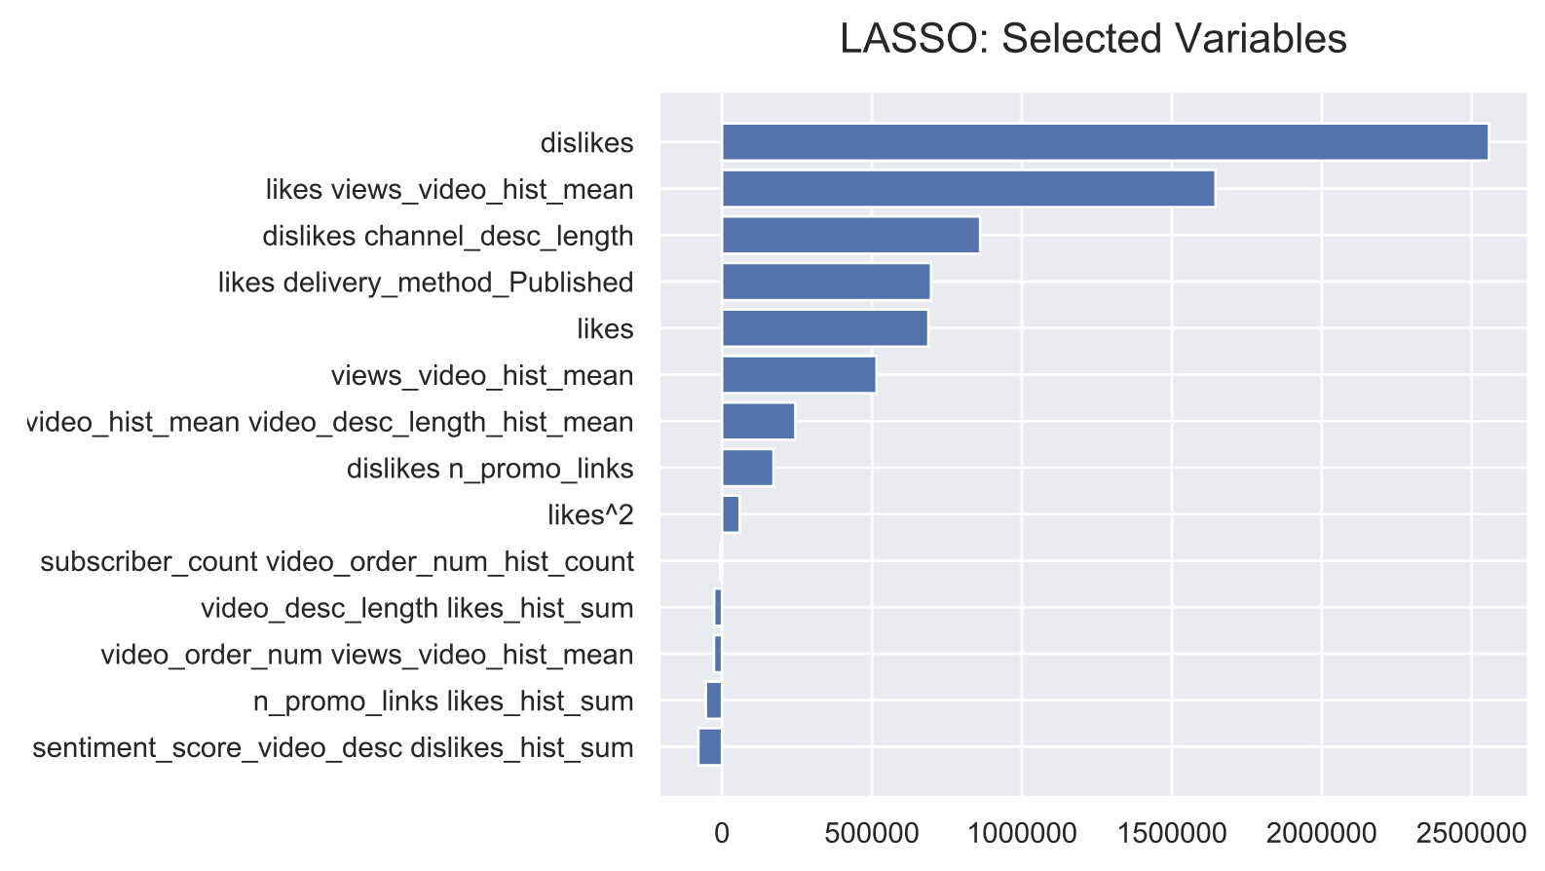
Modeling Results: Power Variables

Slide 9
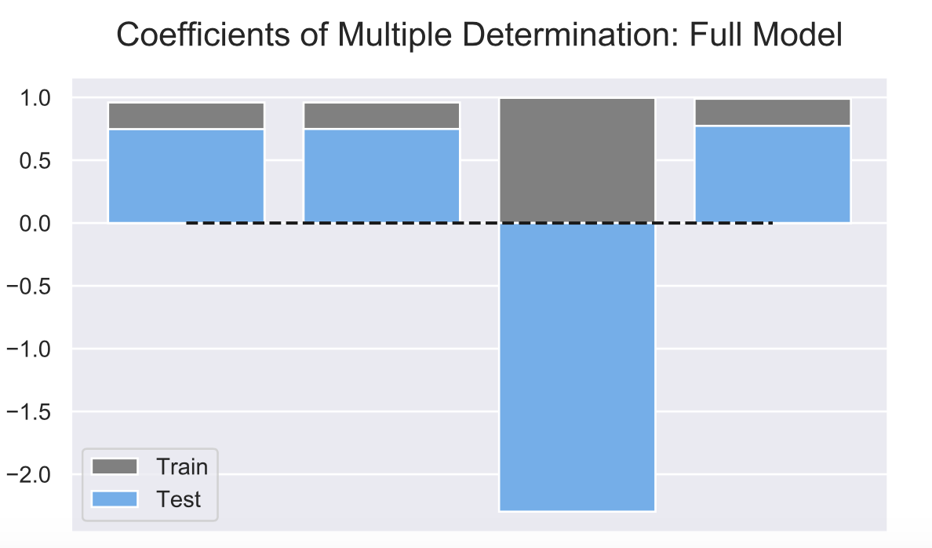
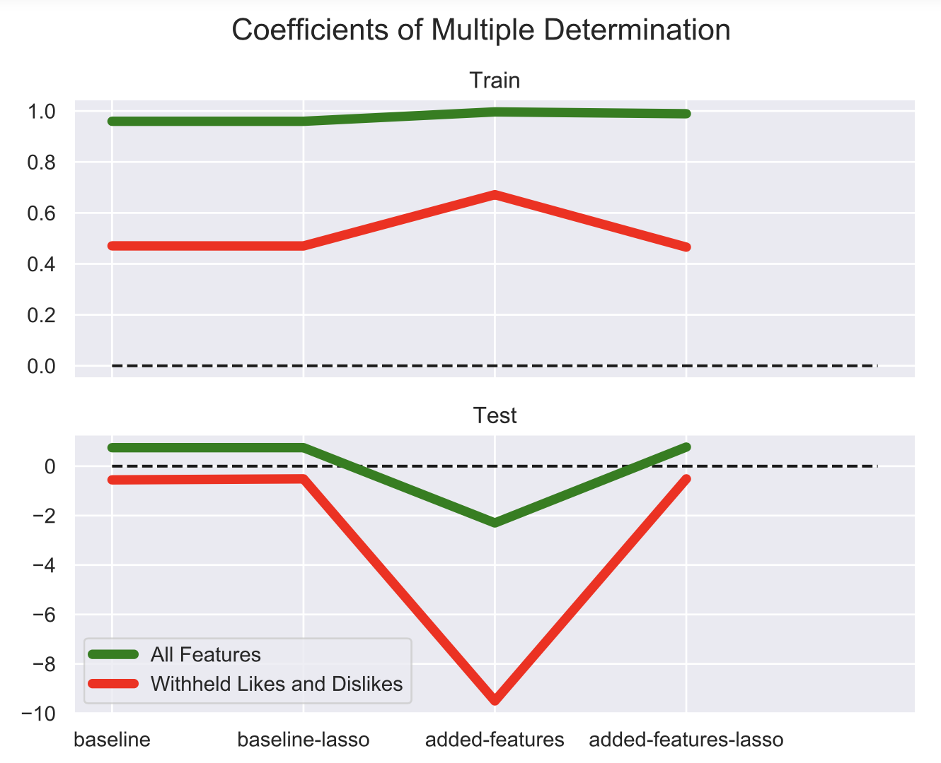
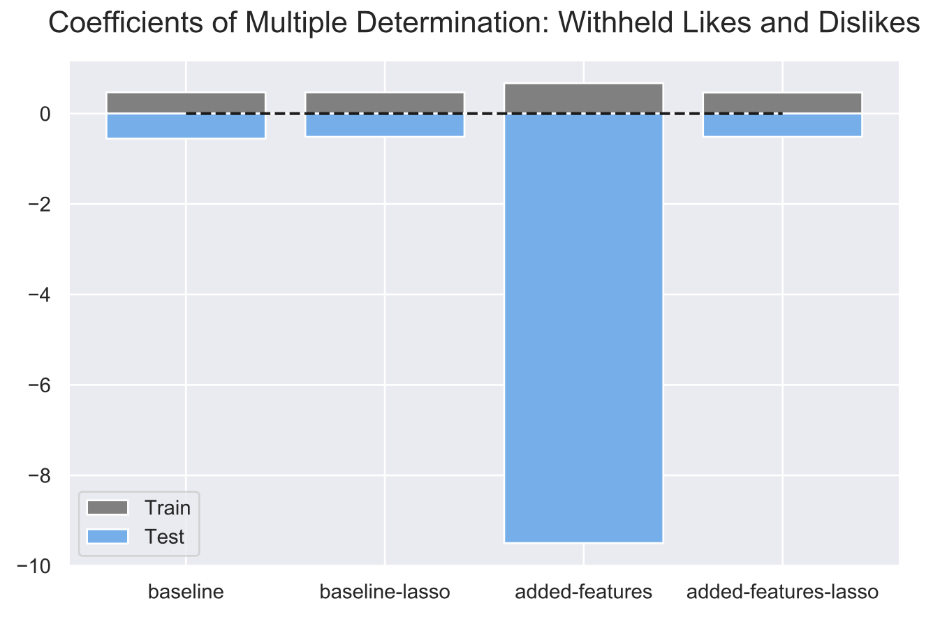
Modeling Results: R2
0.96
0.99
0.75
0.77
0.47
-0.5

Slide 10










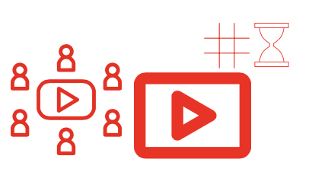
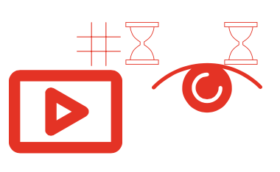


Modeling Results: Best Model Formula
8223.6
191.8
171.0
168.7
5.7
0.137
0.000081
0.000037
0.000006
-0.000807
-0.001086
-0.001206
-0.292
-4.8
MAE = 123K
(sd= 5,523K)

Slide 11
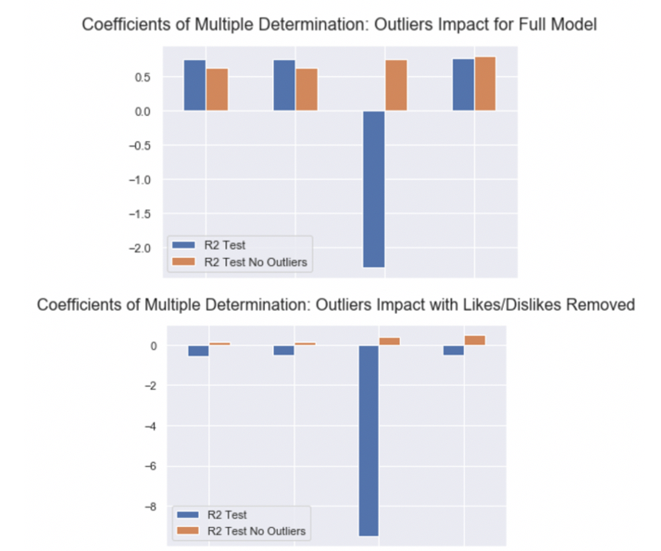
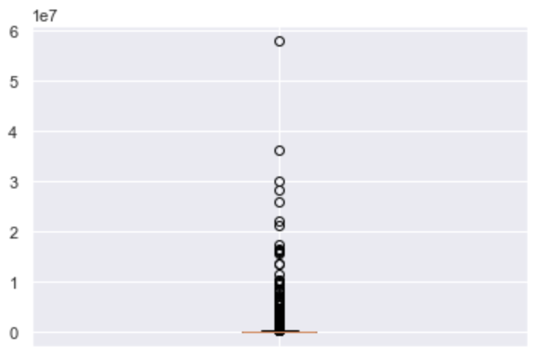
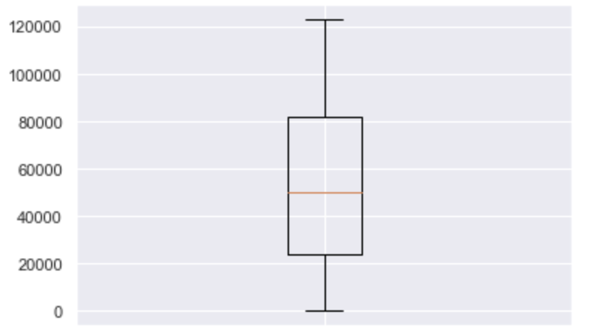
Outliers Impact
Residuals Distribution
0.47
MAE = 123K
(sd = 5,523K)
MAE = 12K
(sd = 95K)
Notes:
Mae = 12K

Slide 12
Findings
likes & dislikes have most predictive power
most meaningful interactions: likes, dislikes, or historical data
features discovered are insufficient to predict views for new videos
Notes:
Statistical features, historical data, and basic text features
with lissing information about likes and dislikes.

Slide 13
Appendix

Slide 14
Learnings
regularization does not work if there is not enough information
high variance of outcomes (changing seeds) signals about outliers
lasso outperforms ridge in case of irrelevant features present

Slide 15
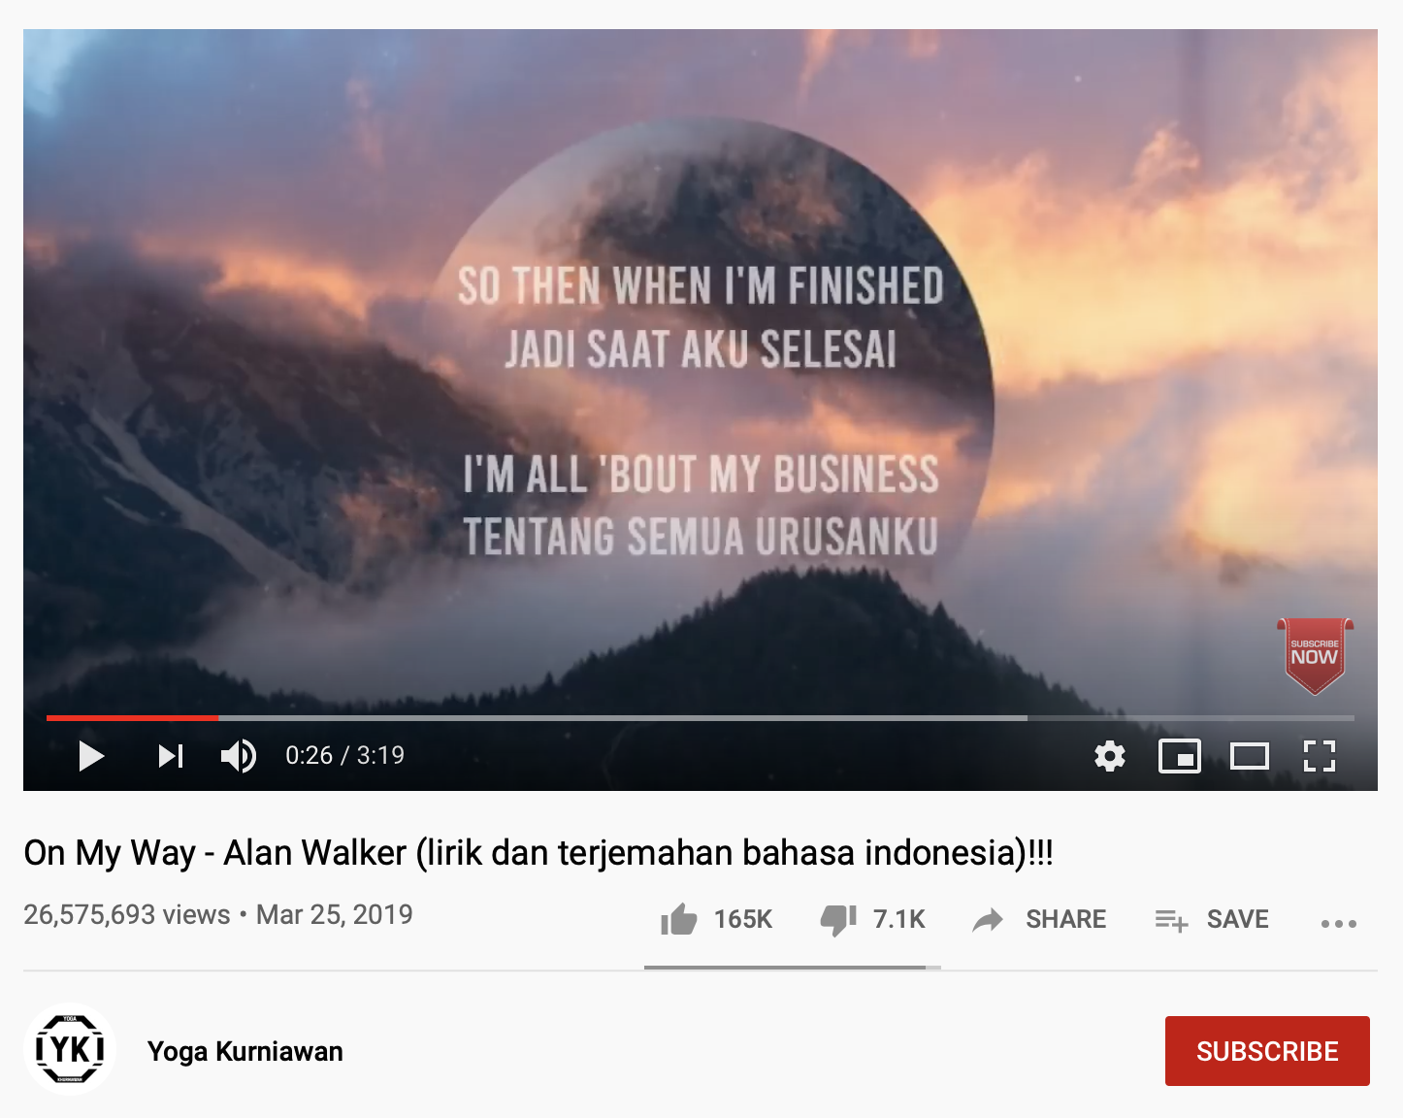
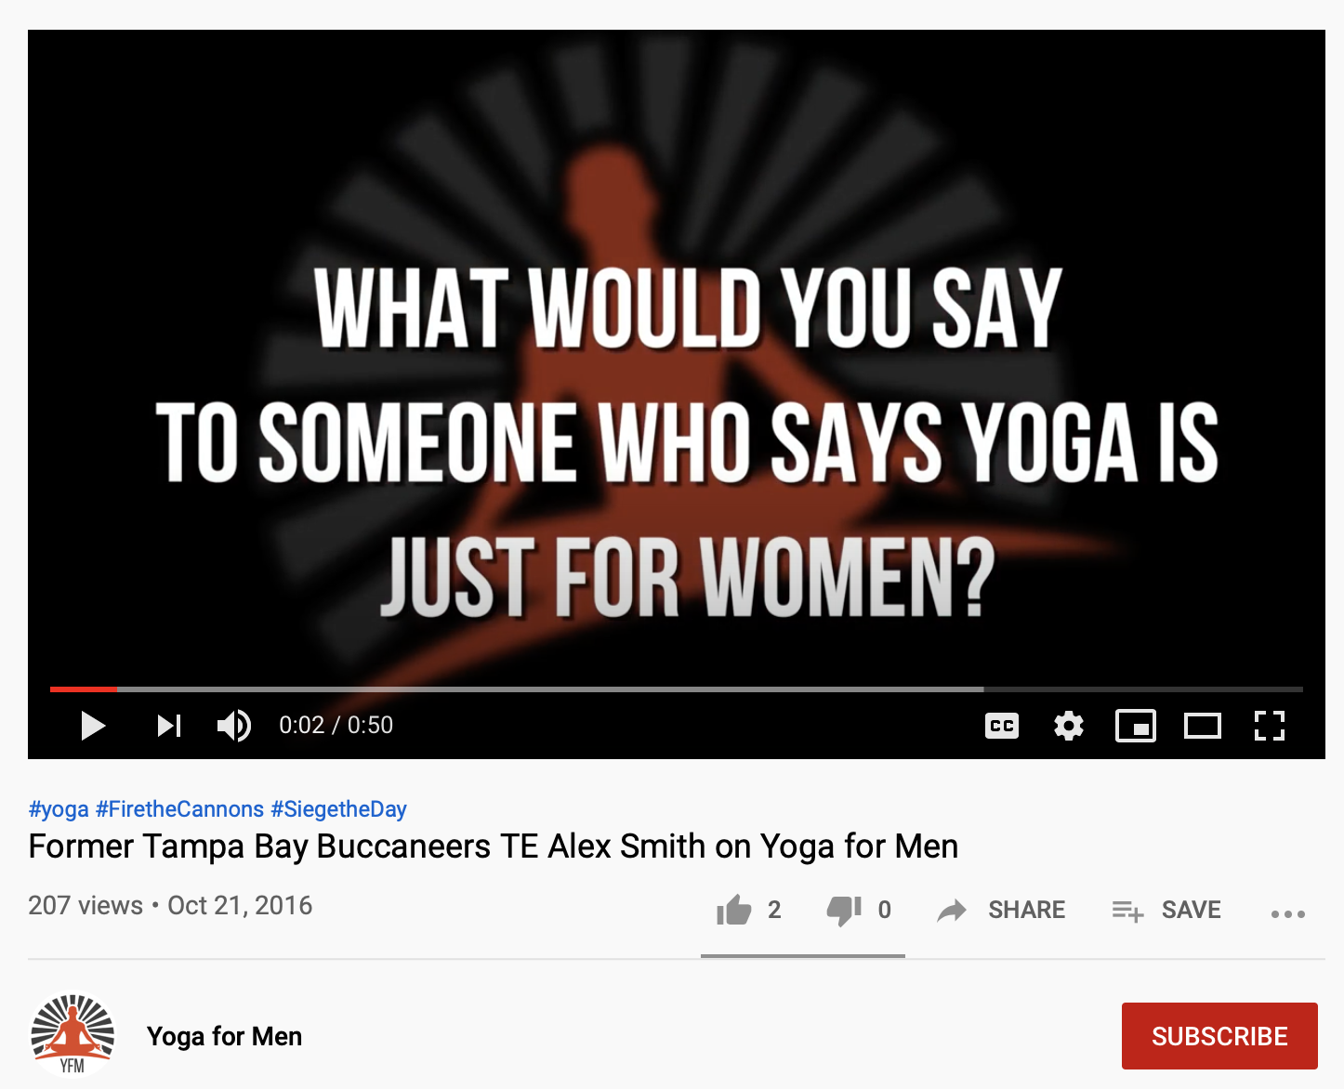
Best and Worst Predictions
10-fold overpredicted
10-fold overpredicted

Slide 16
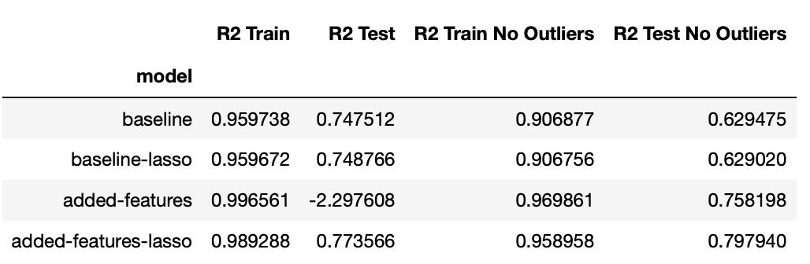
Full Model (including Likes and Dislikes)

Slide 17
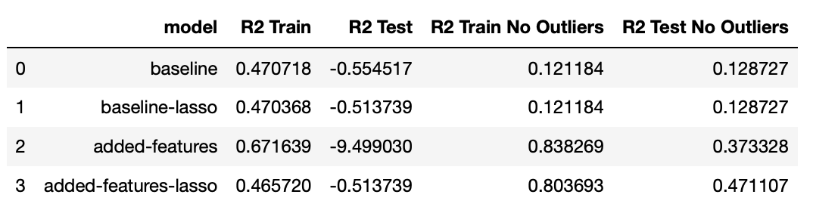
Reduced Model (excluding Likes and Dislikes)

Slide 18
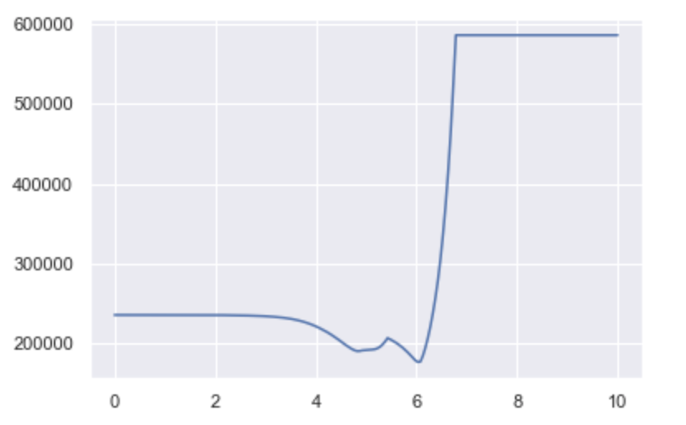
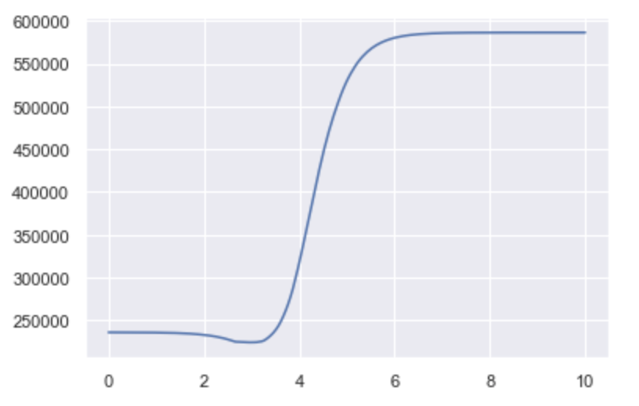
Lasso & Ridge Manual Cross-Validation

Slide 19
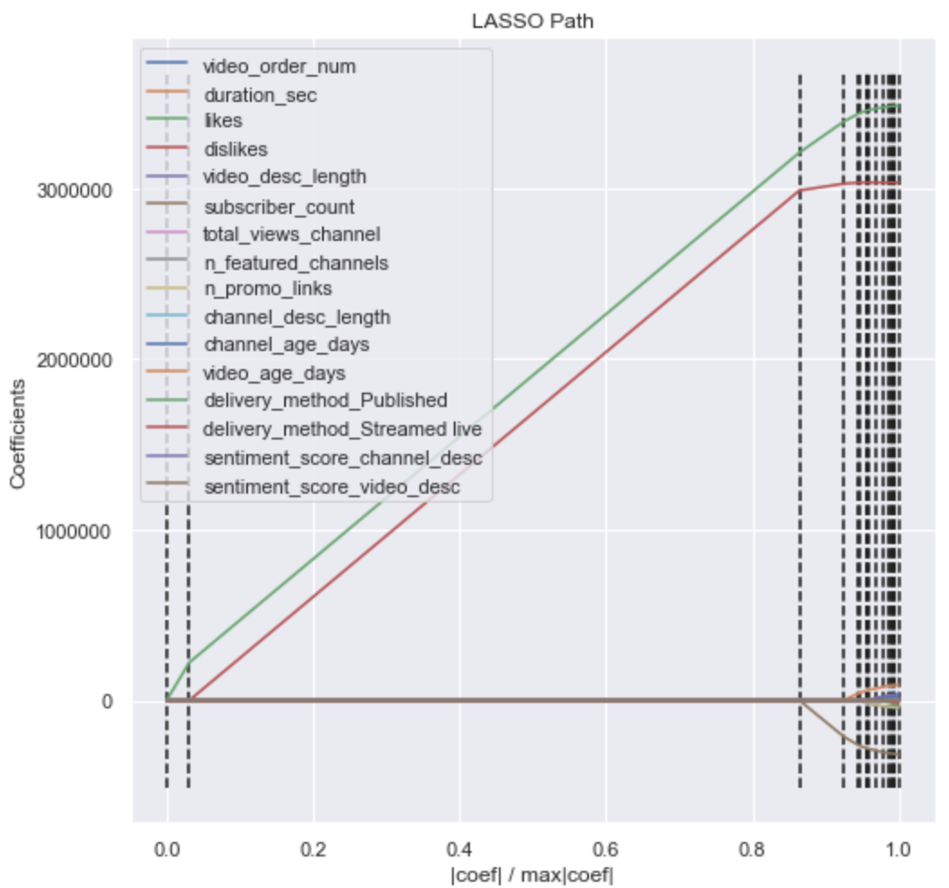
Features Power

Slide 20
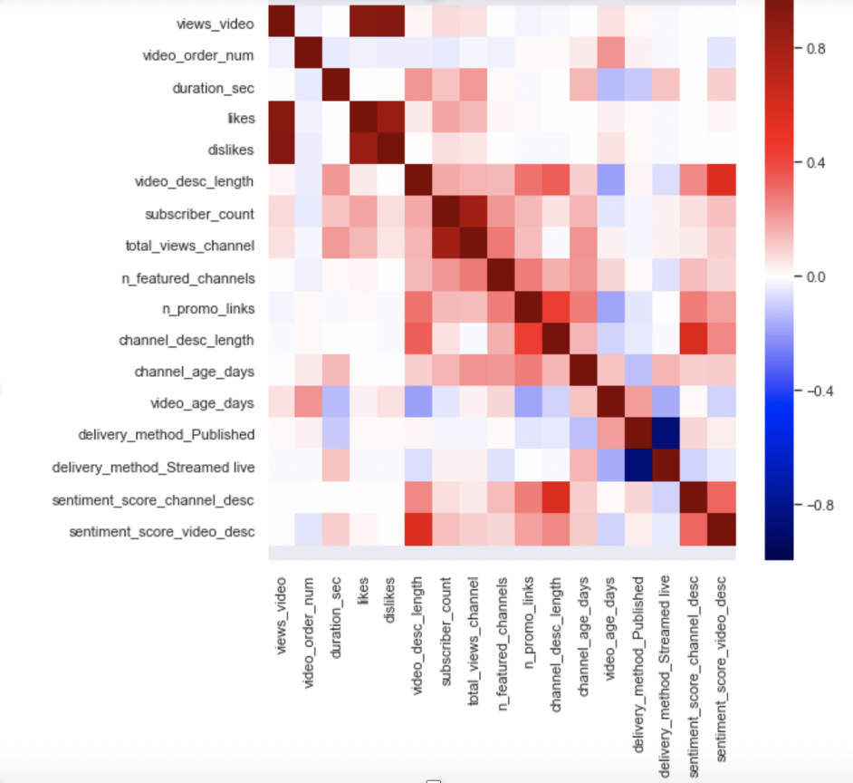
Correlations

Slide 21
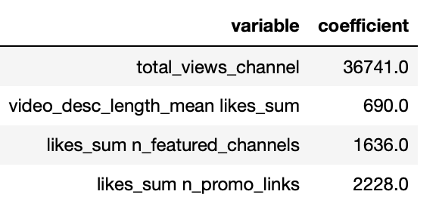
Bonus Project: Predict Number of Channel subscriptions
Baseline R2 (train, test)
0.81, 0.62
Best R2 (train, test)
0.83, 0.81

Slide 22
Git Repository
https://github.com/elena-du/Metis-Project-2---Youtube-Predictions.git

